Slide 1
Improving a Hypercube Structured Distributed Hash Table
James R. Wilburn
Mentor: Dr. Udaya Shankar
Notes:
Add university under Dr

Slide 2
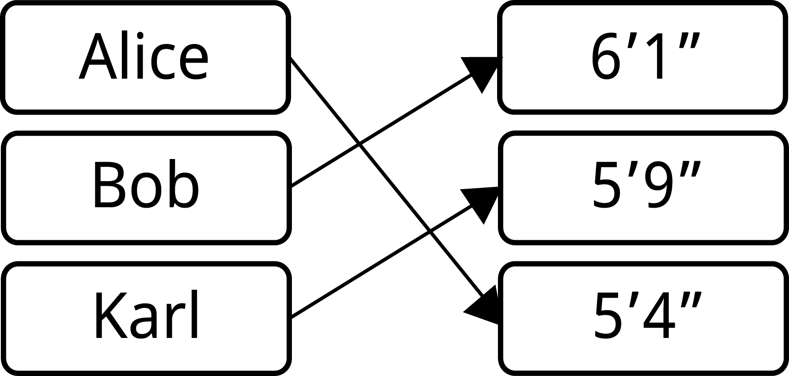
What is a Hash Table?
Store data
Map keys to values
Can get, set, or delete

Slide 3
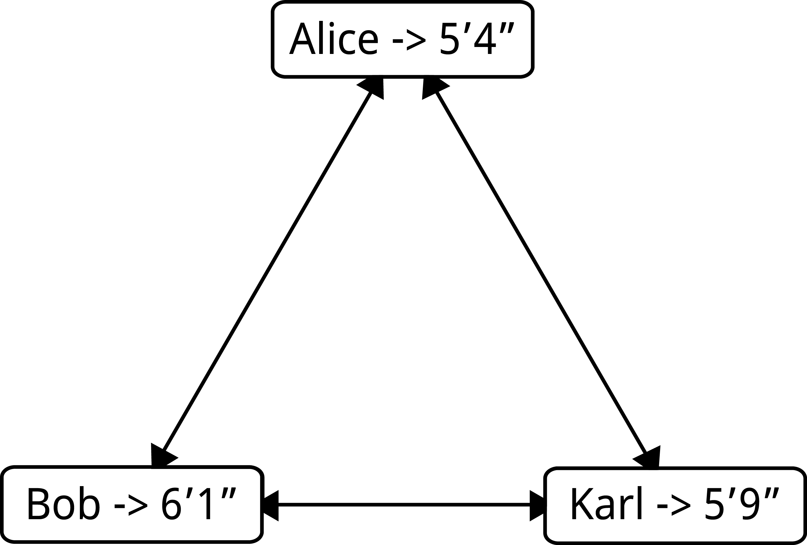
What is a Distributed Hash Table?
Transparent
Can still get, set, or delete
Data spread across a network

Slide 4
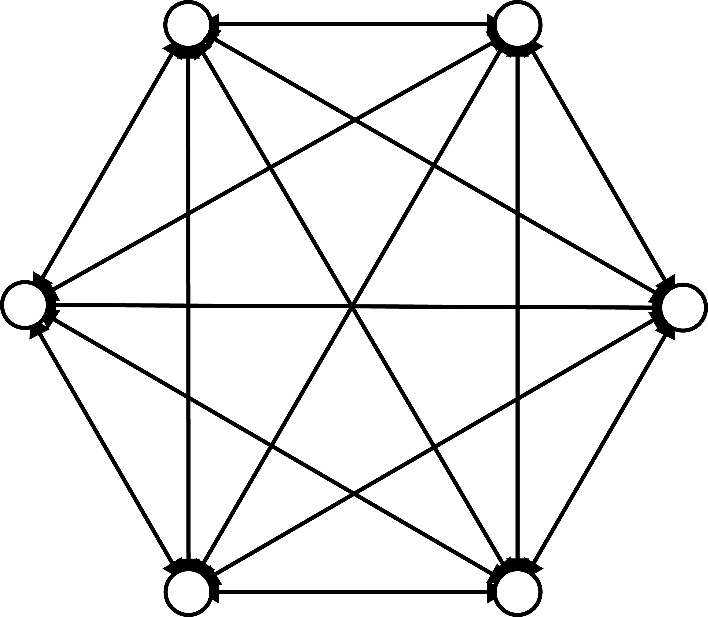
Unstructured Clusters
n vertices
n-1 edges per vertex

Slide 5
Advantages
Max distance of 1
Easy to maintain when small
Adapts to change
Redundant links

Slide 6
Disadvantages
Slow at large sizes
Search is slow

Slide 7
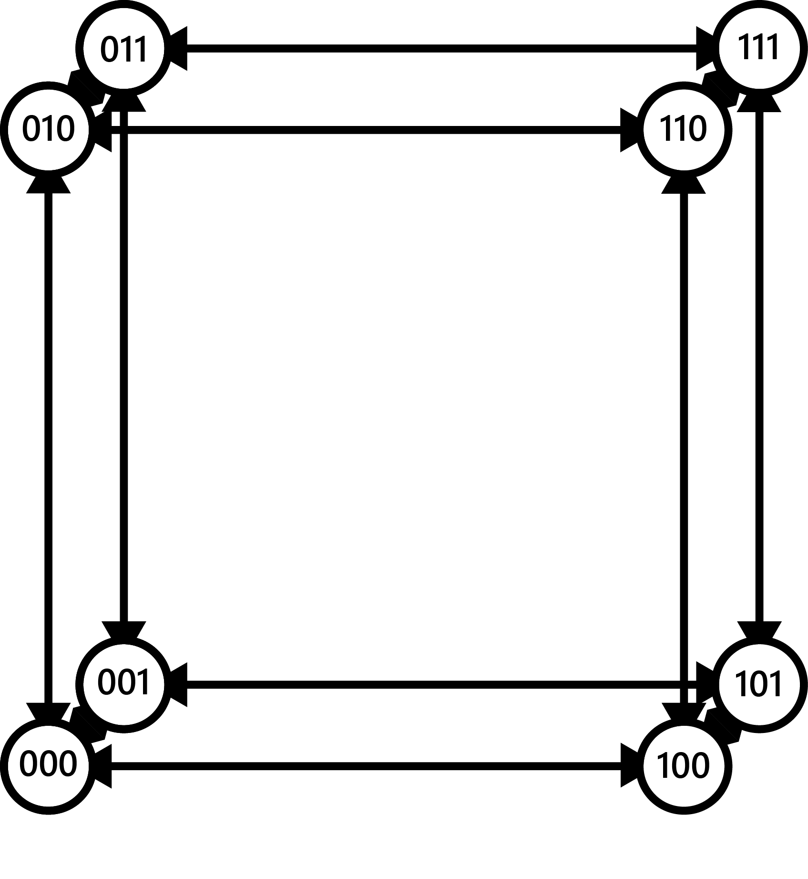
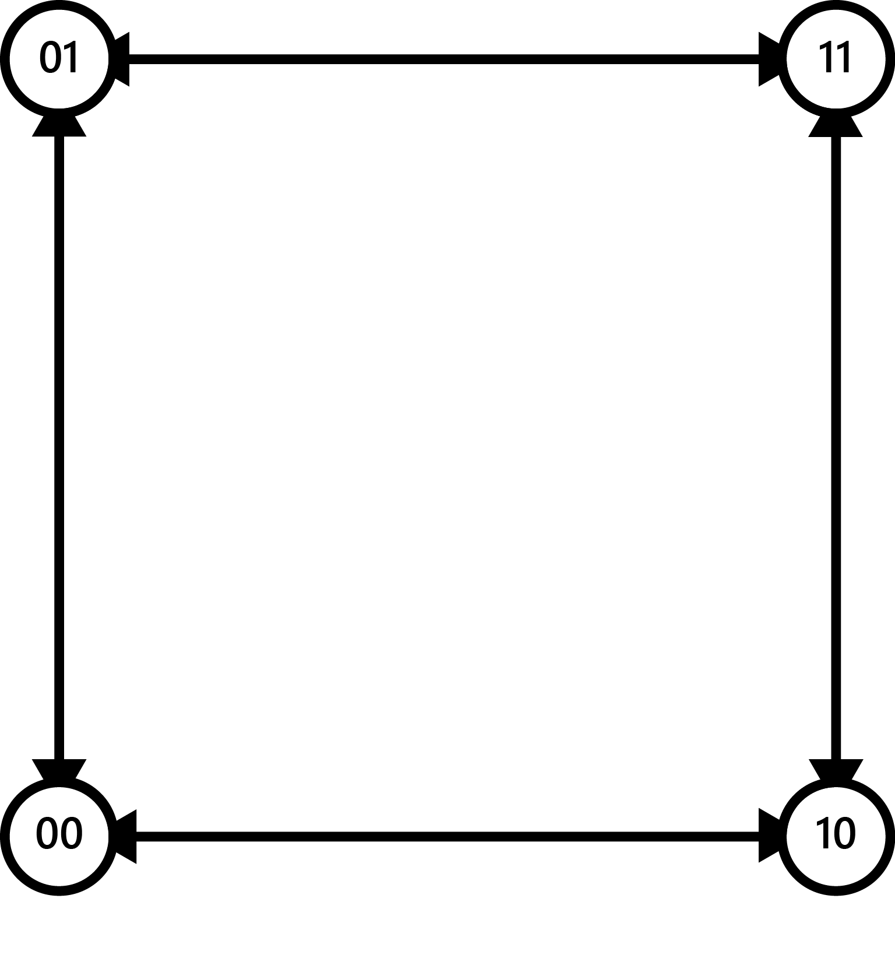
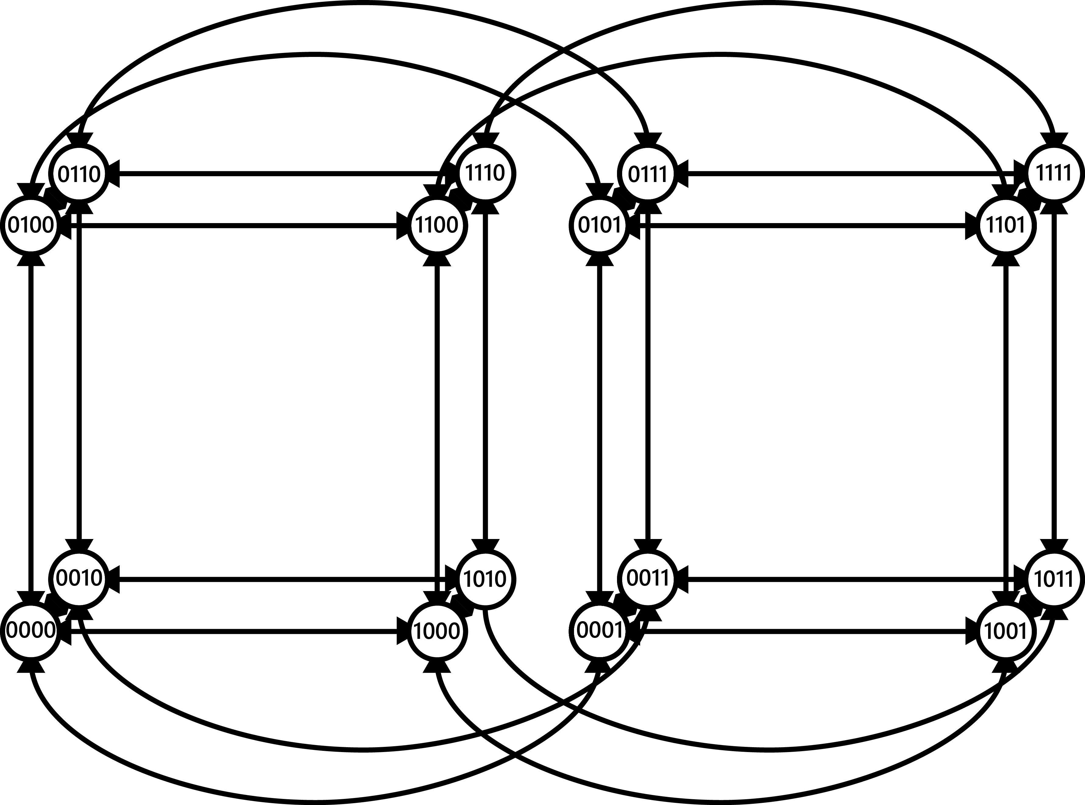
Hypercubic Networks
2^{n} vertices
n edges per vertex
Recursive design
Labelled vertices

Slide 8
Advantages
Short max distance
Redundant links
Dynamic growth
Search is fast

Slide 9
Disadvantages
Hard to maintain
Weak to change

Slide 10
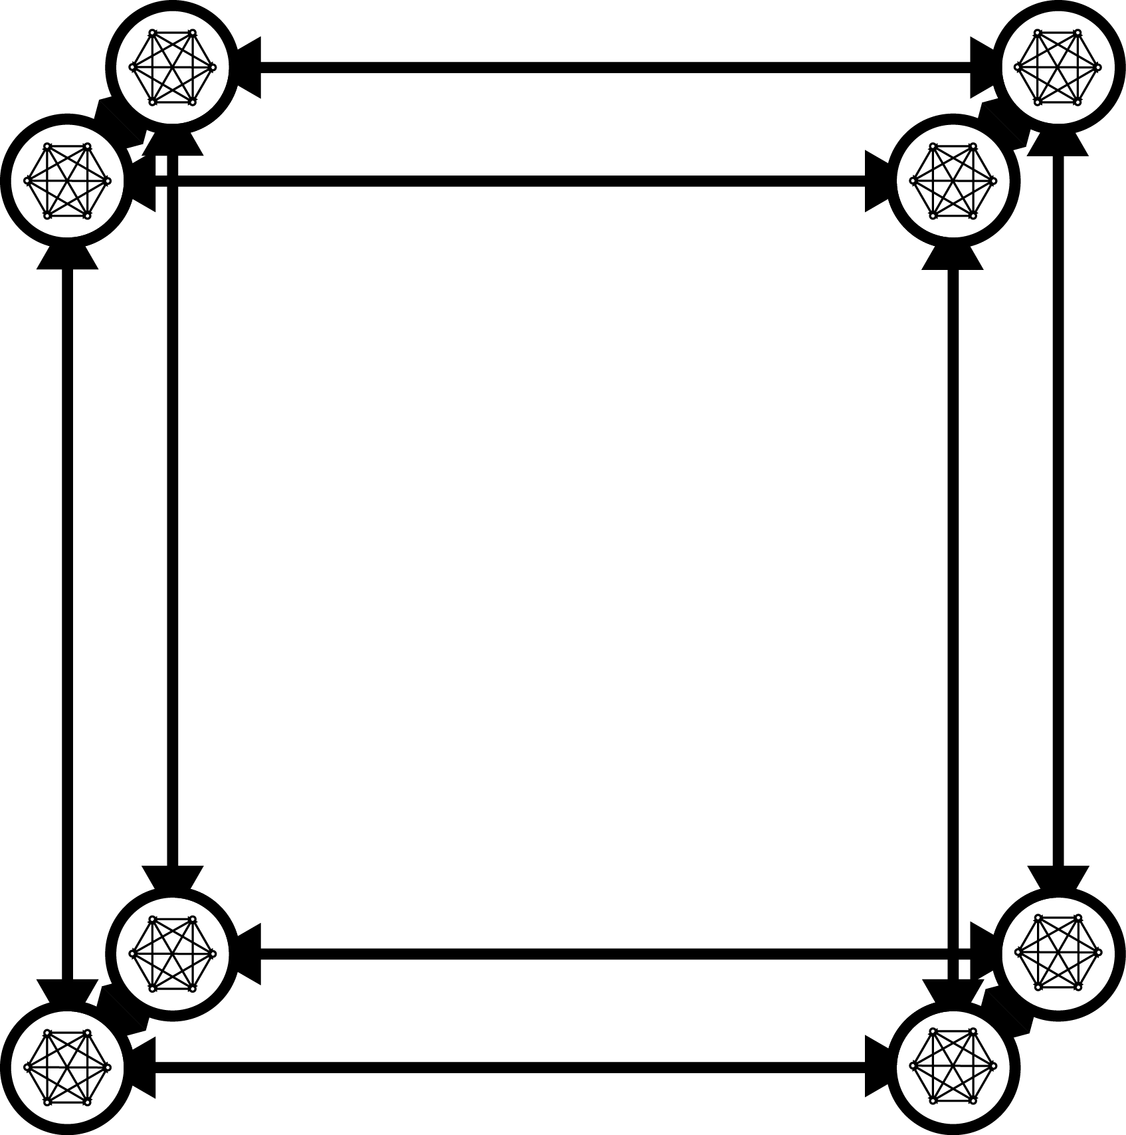
PeerCube
Cluster at each vertex
Cluster data replication
Limited cluster size

Slide 11
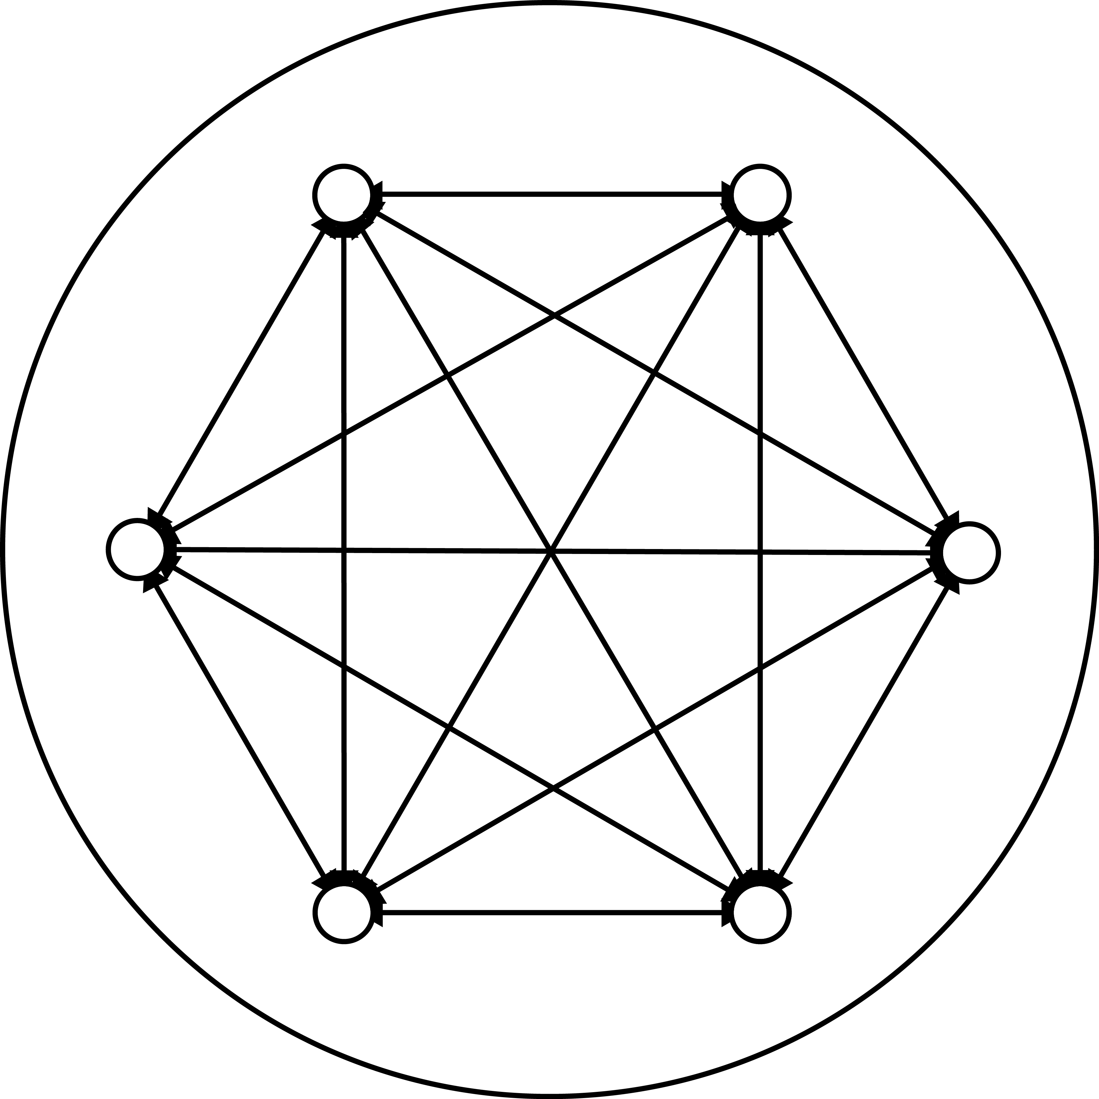
PeerCube Clusters
Grow and Shrink
Merge and Split
Share data internally
Smin and Smax

Slide 12
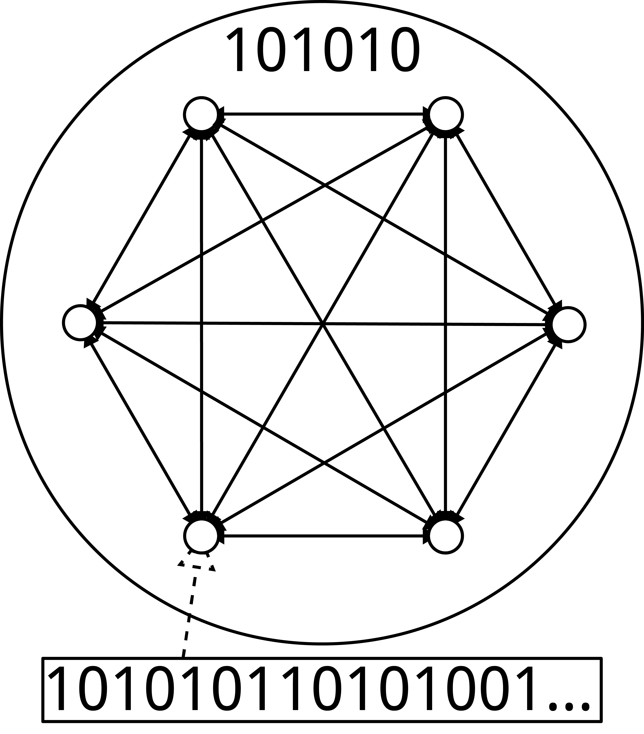
PeerCube Nodes
Randomly assigned ID
Prefixed by cluster label
Not trusted

Slide 13
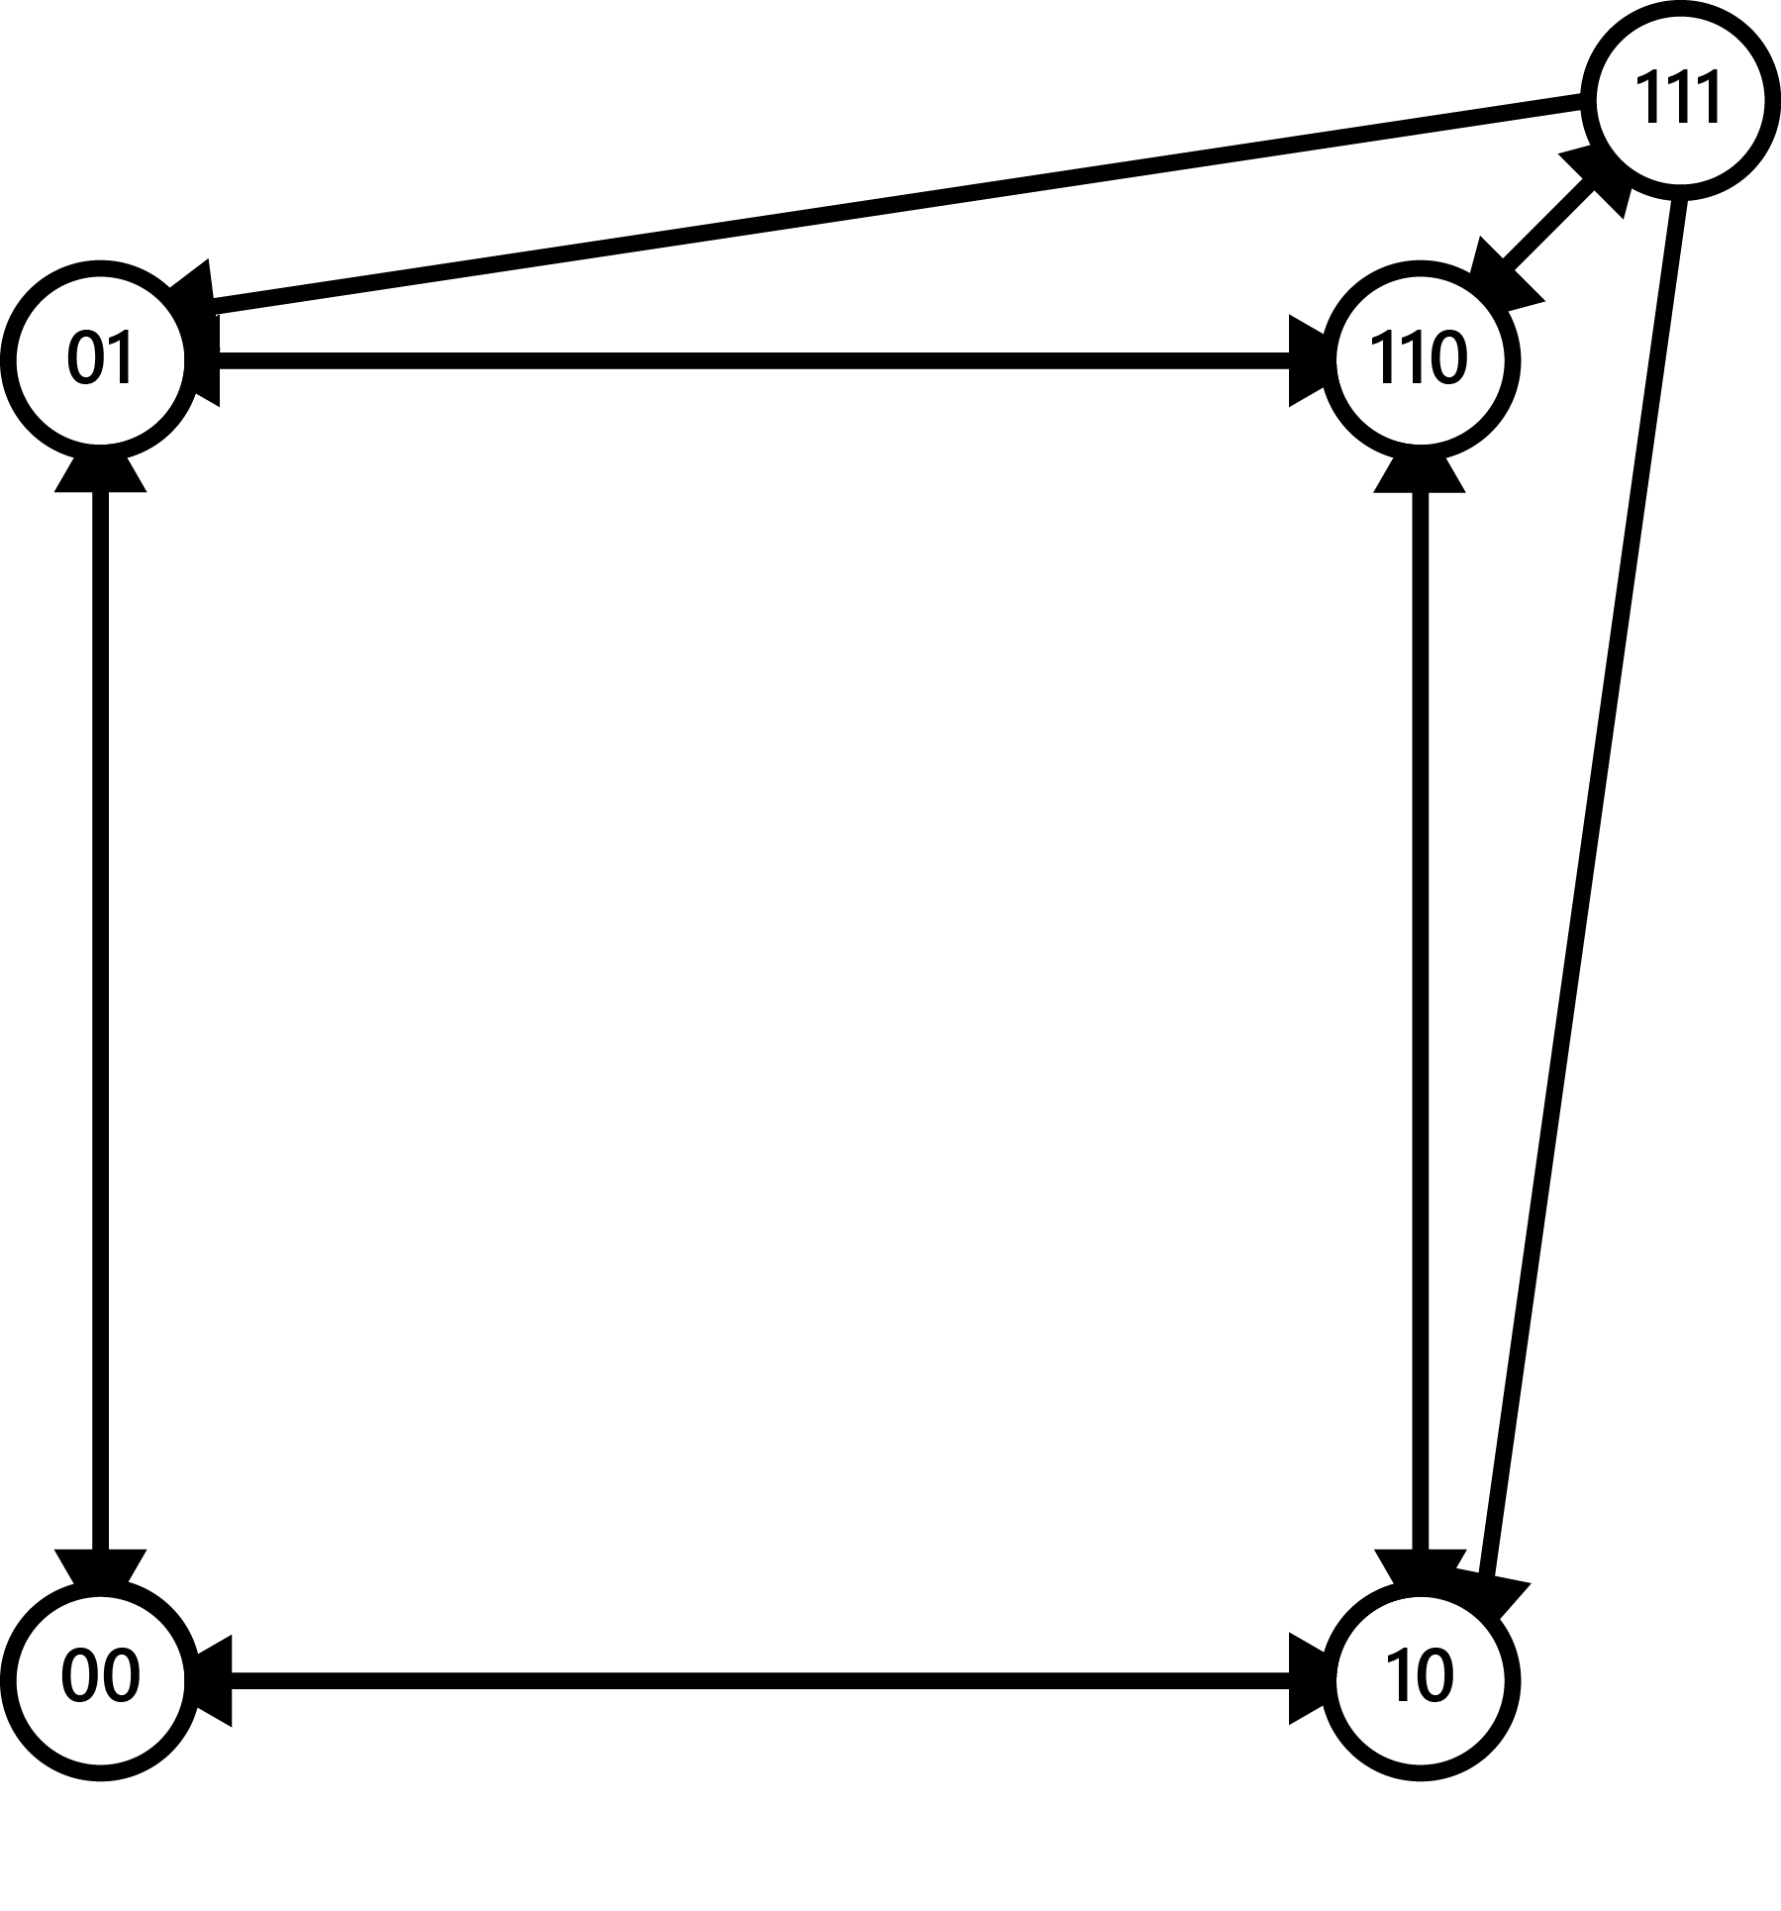
Cluster Splitting
When the cluster is larger than Smax
Makes two clusters smaller than Smax
Links can be unidirectional

Slide 14
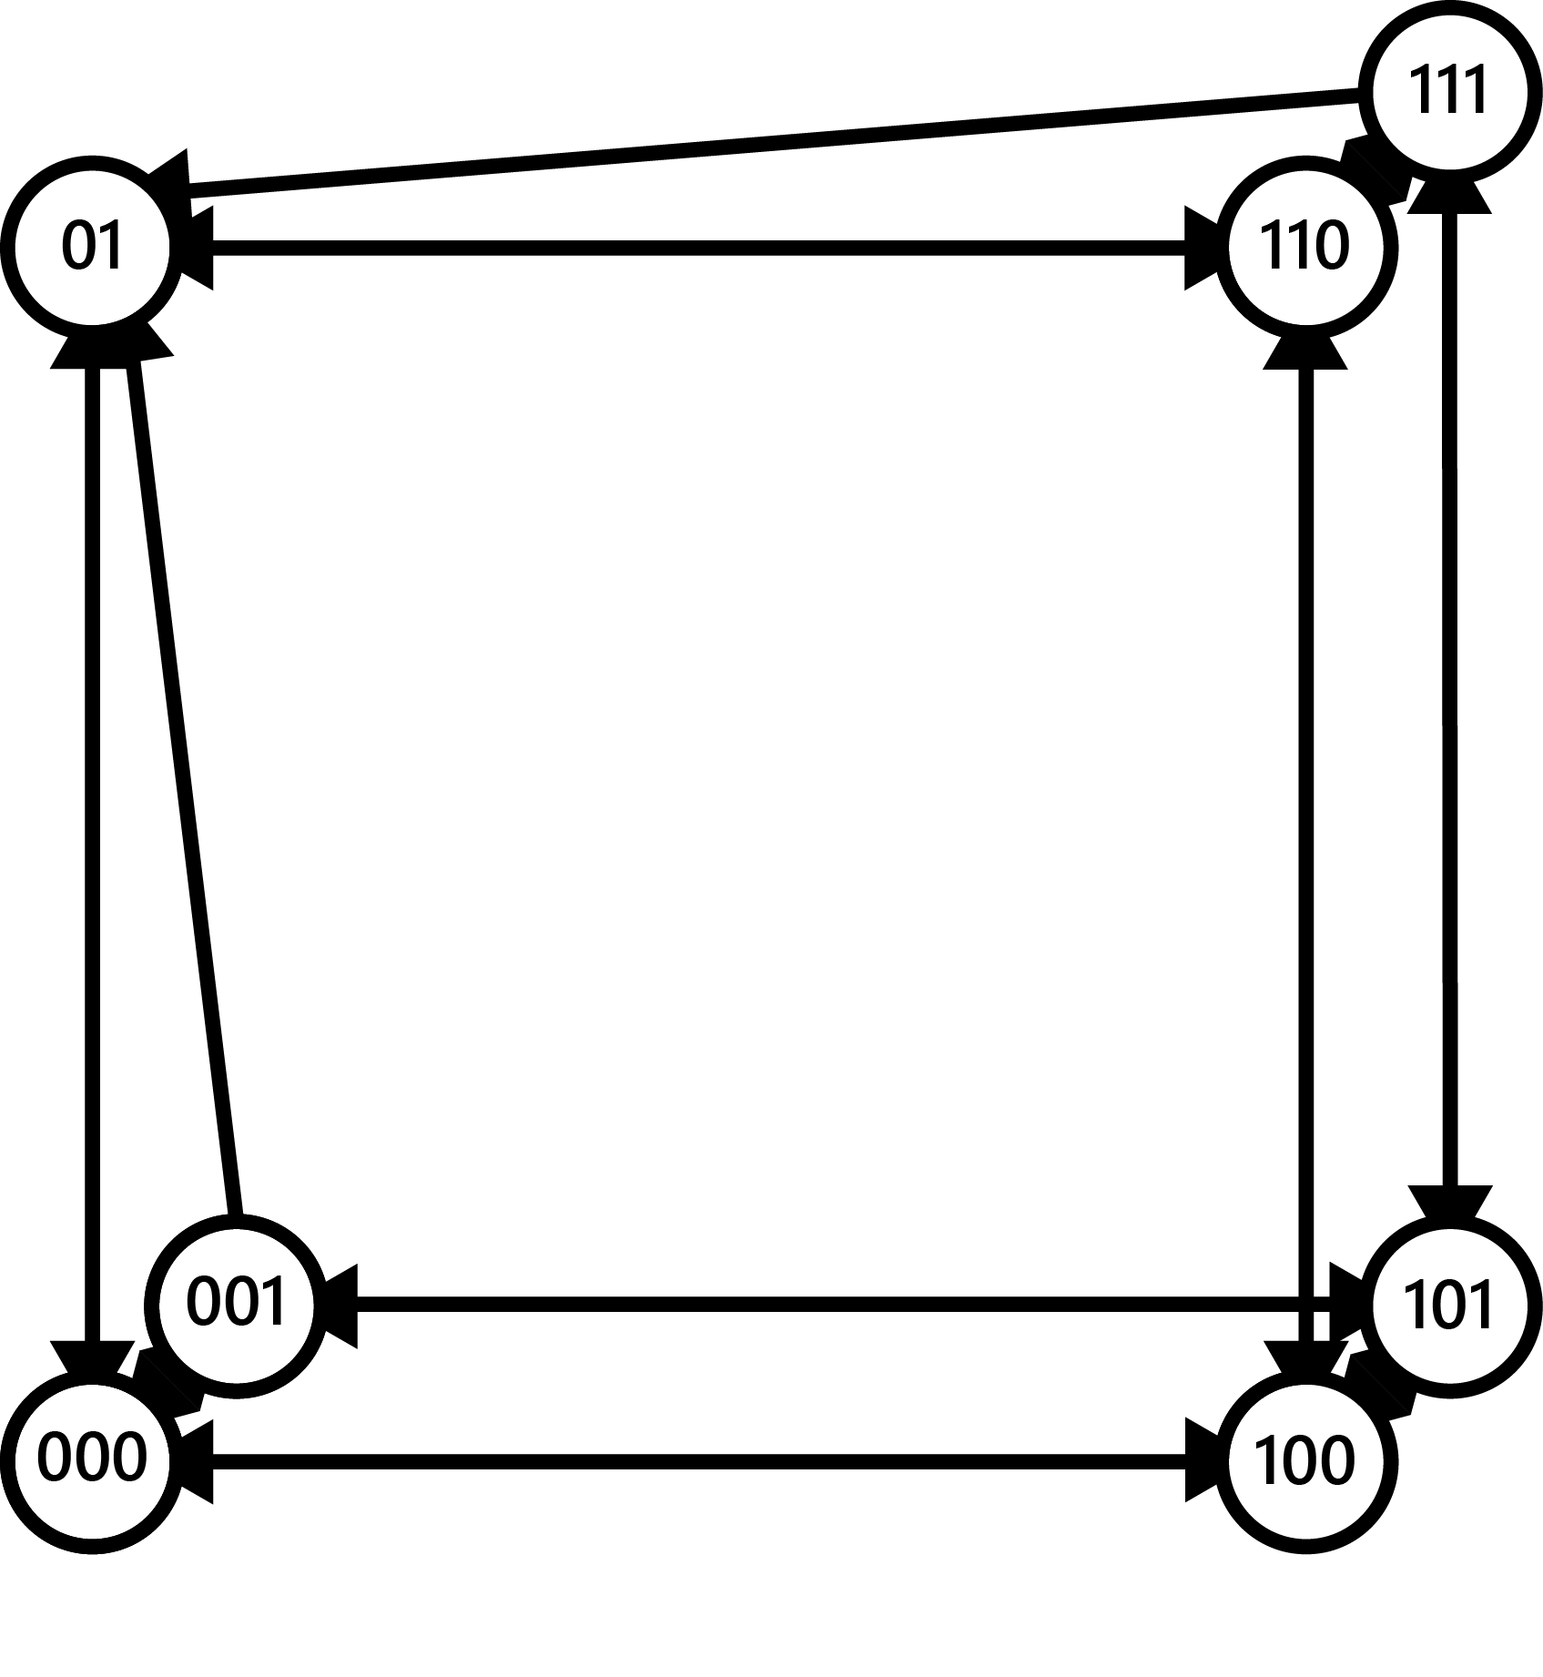
Cluster Merging
When the cluster is smaller than Smin
Makes one cluster larger than Smin
More than two clusters can merge

Slide 15
Problems
No data prioritization
All data is in memory

Slide 16
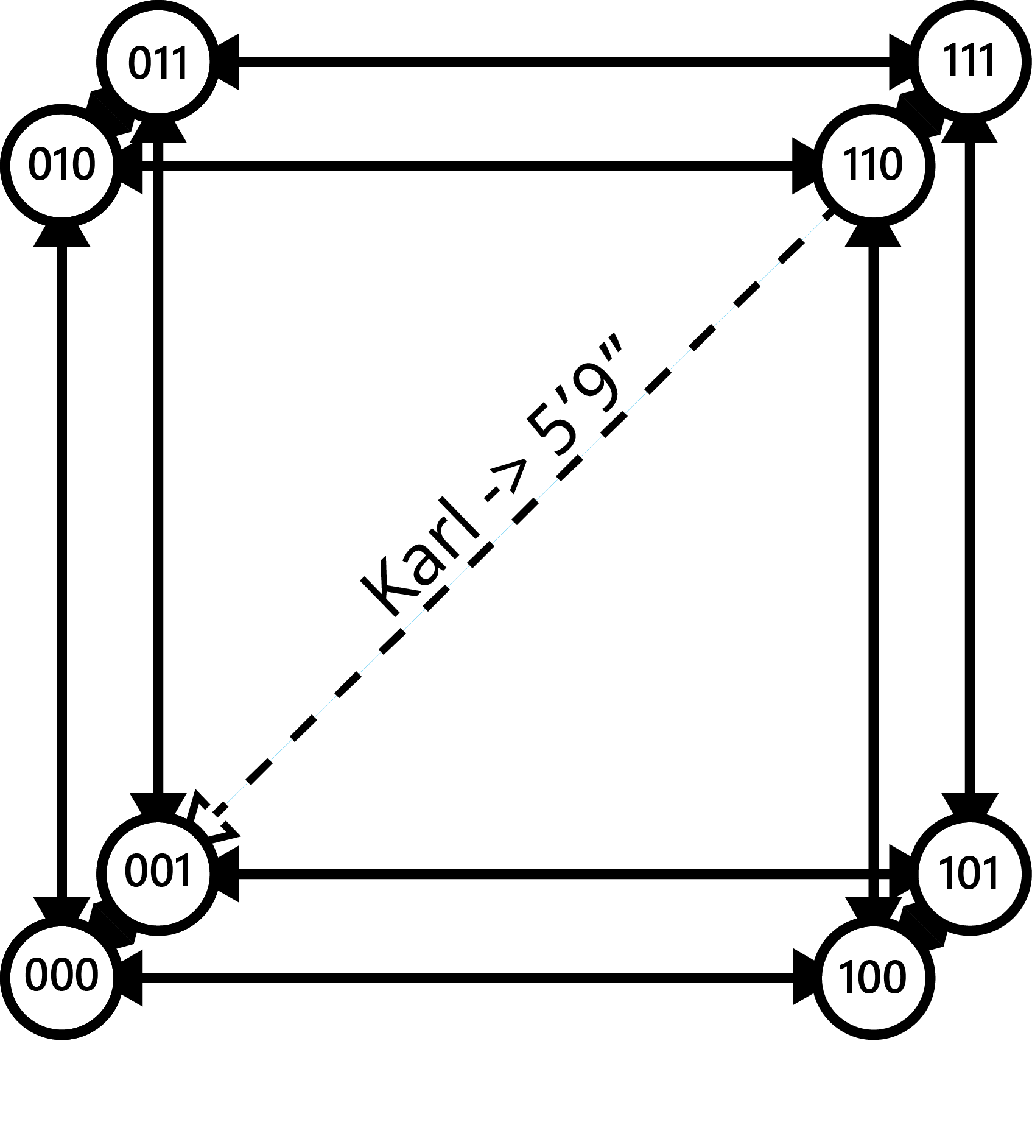
Hot Data Caching
Cache frequently accessed data
Preempt structure
Key-specific links
Latency decrease

Slide 17

Cold Data Paging
Page infrequently accessed data to disk
Saves RAM
Minimal latency increase

Slide 18
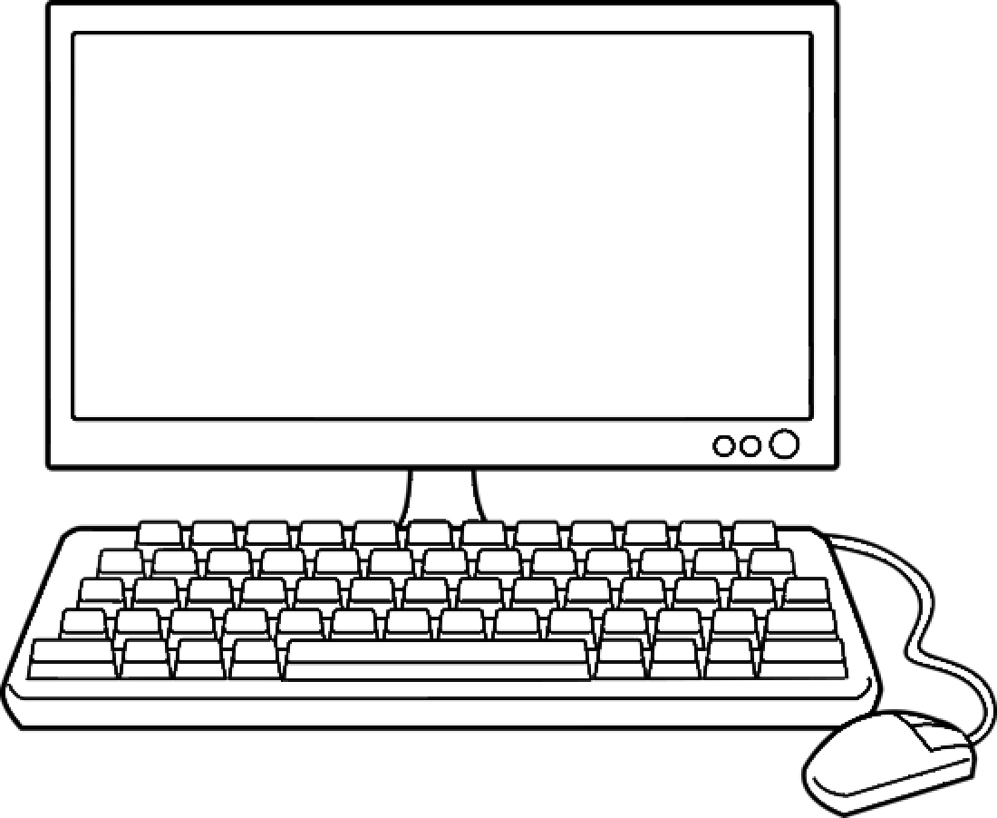
Simulation
Combinations of μ, worker threads, and algorithm modifications
Mean requests per second
Mean 95th percentile latency
Every minute for 30 minutes

Slide 19
Results

Slide 20
Results

Slide 21
Significance
Matches PeerCube model
Paging
Minimal negative impact
Major positive impact
Caching
Slightly lower latency
Much higher throughput

Slide 22
Acknowledgements
Dr. Udaya Shankar
Mrs. Sekhsaria
Mr. Curran
My Family

Slide 23

Questions

